Slide 1

APPLYING GENETIC ALGORITHM FOR SOLVING SIMPLISTIC VEHICLE ROUTING PROBLEM
Submitted By -
Harshini Borugadda
23MCMI13
Guided By -
Dr. Naveen Nekuri
Assistant Professor, UOH

Slide 2
Contents
Introduction
GA for VRP
GA set-up
Initialization and Fitness Function
Selection, Cross-over, Mutation
Running GA
Plotting Function
Results
References

Slide 3
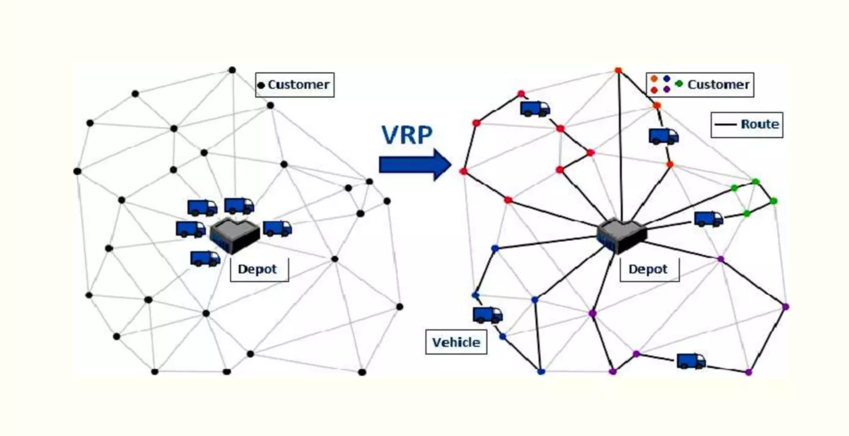
Introduction
The VRP involves finding the best routes from a central depot to multiple destinations, considering various constraints such as cost, vehicle limitations, route length, and time windows.
Objective Functions
To optimize the total distance traveled by all trucks.
Travel distributed evenly among trucks.
Src: https://www.slideshare.net/slideshow/vrppptx/253340871#5

Slide 4
GA for VRP
Each individual represents a VRP solution.
Random solutions are created as a population using the `toolbox.population` function.
The fitness function calculates total distance and balance penalty for each solution, making it a multi-objective optimization problem.
Crossover uses Partially Matched Crossover (PMX), mutation uses Shuffle Indexes, and selection uses Tournament selection.
The evolution process runs for 300 generations with specific probabilities for crossover and mutation.
The best solution is stored in a Hall of Fame, and visualization is done using the `plot_routes` function.

Slide 5
GA for VRP
Key aspects:
1. Multi-objective Optimization: Considers both total distance and load balance.
2. Permutation-based Encoding: Solutions are represented as permutations of location indices.
3. Specialized Genetic Operators: Crossover and mutation are designed for permutations.
4. Population-based Approach: Multiple solutions are evolved simultaneously.
5. Iterative Improvement: Over generations, the population evolves towards better solutions.
This approach allows the genetic algorithm to explore a wide range of routing solutions, gradually improving them over time to find a near-optimal solution that minimizes total distance and balances vehicle workload.

Slide 6
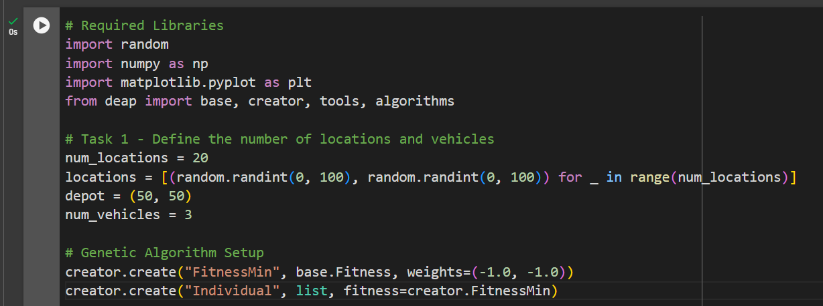
GA set-up

Slide 7
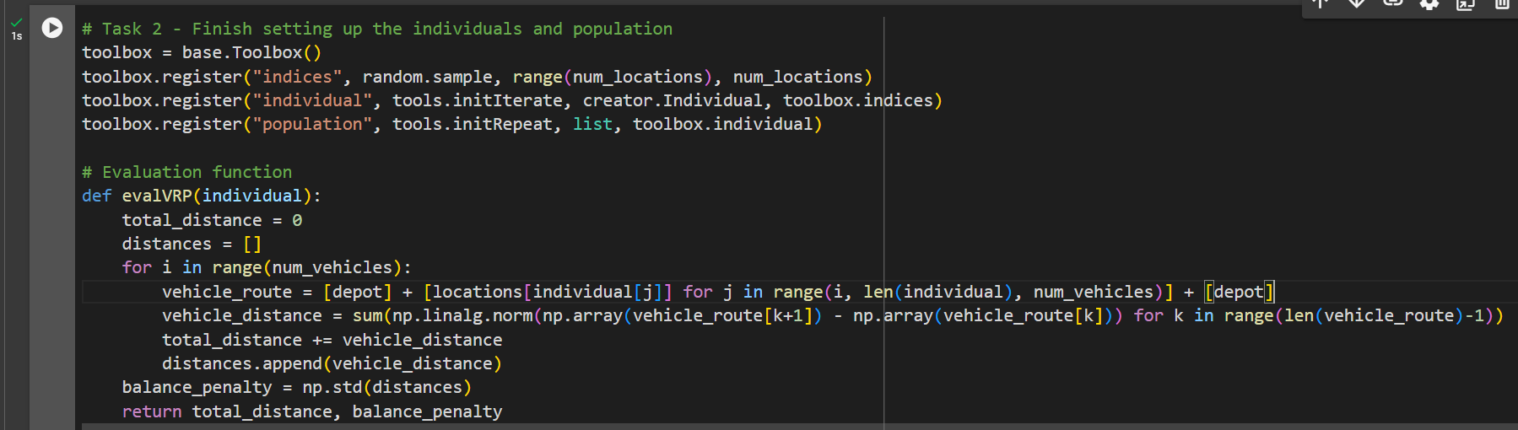
Initialization and Fitness Function

Slide 8
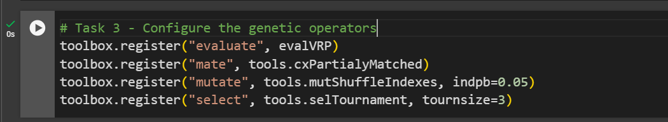
Selection, Cross-over, Mutation

Slide 9
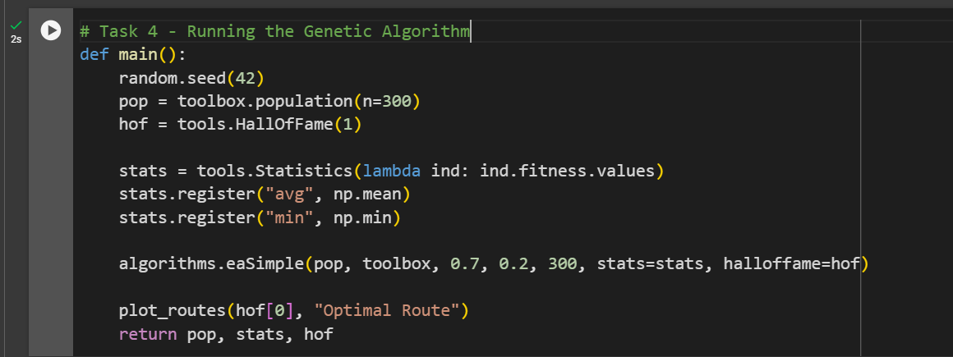
Running GA

Slide 10
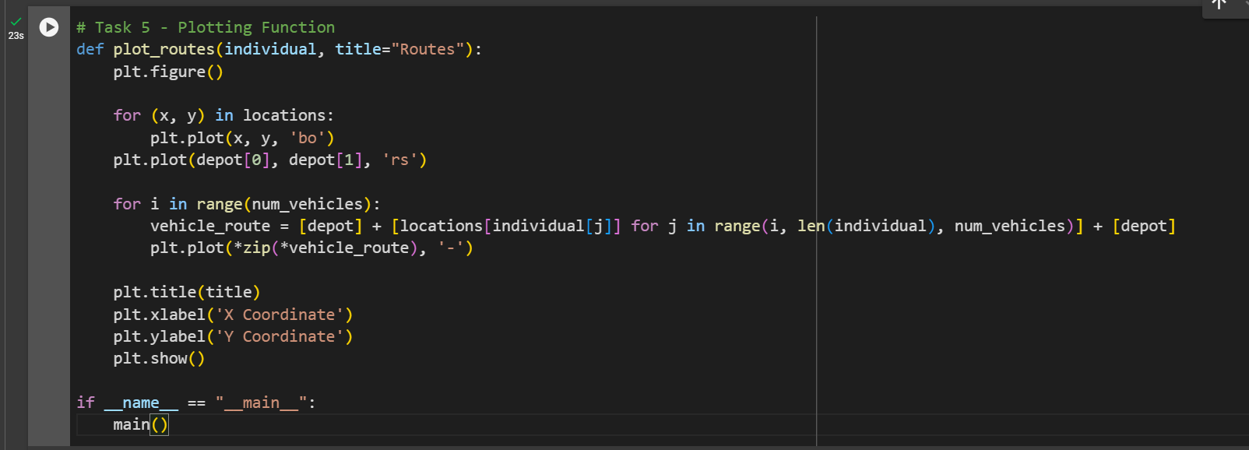
Plotting Function

Slide 11
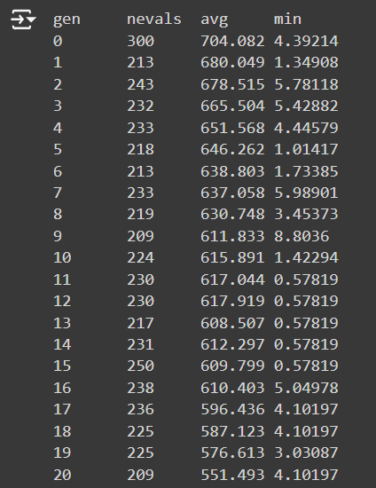
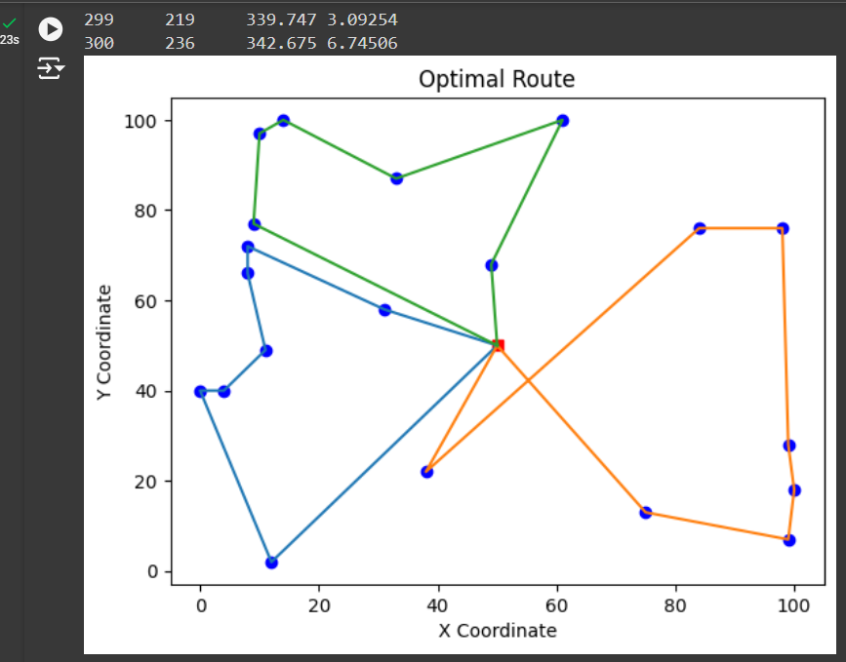
Results

Slide 12
References
https://deap.readthedocs.io/en/master/index.html
https://www.slideshare.net/slideshow/vrppptx/253340871#5

Slide 13
Thank You

